Slide 1
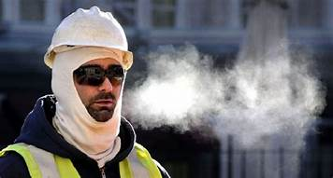
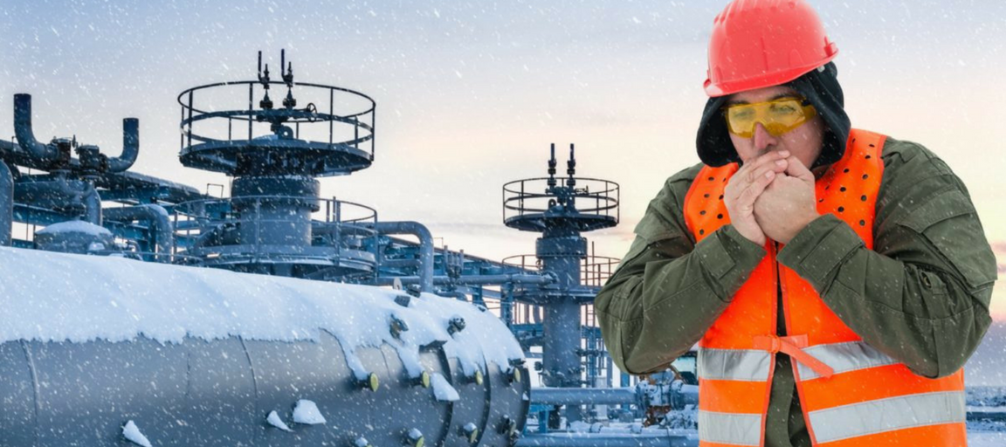
Winter Weather Tips
Mariana Patton
Upper Valley Career Center Adult Division

Slide 2
Terminology
OSHA standard
Employer responsibilities
Engineering controls
Dressing properly for the Cold
Safety Tips for Outdoor Workers
Winter Weather Driving
Electronics Safety

Slide 3
Terminology
Blizzard: Blowing and/or falling snow with winds of at least 35 mph, reducing visibilities to a quarter of a mile or less for at least three hours. Winds lofting the current snow pack and reducing visibilities without any falling snow is called a ground blizzard.
Freezing Rain: Caused by rain falling on surfaces with a temperature below freezing. The rain freezes upon contact with the ground. Large build-ups of ice can down trees and power lines and coat roads.

Slide 4
Terminology
Sleet: Rain/melted snow that has begun refreezing when it reaches the ground. Sleet tends to be softer than hail and is easily compacted. Sleet can make roads slippery very quickly.
Wind Chill: The apparent temperature the body feels when wind is factored into the equation.

Slide 5
Wind Chill
Wind strips away the thin layer of warm air above your skin. The stronger the wind, the more heat lost from your body, and the colder it will feel.
When the winds are light, it will feel closer to the actual air temperature.

Slide 7
Although OSHA does not have a specific standard that covers working in cold environments, employers have a responsibility to provide workers with employment and a place of employment which are free from recognized hazards, including winter weather related hazards, which are causing or are likely to cause death or serious physical harm to them (Section 5(a)(1) of the Occupational Safety and Health Act of 1970).

Slide 8
Employer Responsibility
At a minimum train workers on:
Cold Stress:
How to recognize the symptoms of cold stress and preventing cold stress injuries and illnesses
The importance of self-monitoring and monitoring coworkers for symptoms
First aid and how to call for additional medical assistance in an emergency
How to select proper clothing for cold, wet, and windy conditions

Slide 9
Employer Responsibility
Other winter weather related hazards that workers may be exposed to, for example, slippery roads and surfaces, windy conditions, and downed power lines
Education on hazard recognition
How workers will be protected: engineering controls, safe work practices and proper selection of equipment, including personal protective equipment

Slide 10
Engineering Controls
Engineering controls can be effective in reducing the risk of cold stress.
For example, radiant heaters may be used to warm workplaces like outdoor security stations. If possible, employers should shield work areas from drafts or wind to reduce wind chill.

Slide 11
Engineering Controls
Employers should use engineering controls to protect workers from other winter weather related hazards
For example, aerial lifts or ladders can be used for safely applying de-icing materials to roofs, to protect workers from the hazard of falling through sky lights.

Slide 12
Engineering Controls
Safe work practices that employers can implement to protect workers from injuries, illnesses and fatalities include:
Providing workers with the proper tools and equipment to do their jobs
Developing work plans that identify potential hazards and the safety measures that will be used to protect workers
Scheduling maintenance and repair jobs for warmer months

Slide 13
Engineering Controls
Scheduling jobs that expose workers to the cold weather in the warmer part of the day
Avoiding exposure to extremely cold temperatures when possible
Limiting the amount of time spent outdoors on extremely cold days

Slide 14
Engineering Controls
Using relief workers to assign extra workers for long, demanding jobs
Providing warm areas for use during break periods
Providing warm liquids (no alcohol) to workers
Monitoring workers who are at risk of cold stress
Monitoring the weather conditions during a winter storm, having a reliable means of communicating with workers and being able to stop work or evacuate when necessary

Slide 15
Engineering Controls
Acclimatizing new workers and those returning after time away from work by gradually increasing their workload, and allowing more frequent breaks in warm areas, as they build up a tolerance for working in the cold environment
Having a means of communicating with workers, especially in remote areas
Knowing how the community warns the public about severe weather: outdoor sirens, radio, and television
The National Oceanic and Atmospheric Administration (NOAA) provides multiple ways to stay informed about winter storms. If you are notified of a winter storm watch, advisory or warning, follow instructions from your local authorities: NOAA Weather Radio

Slide 16
Dressing Properly for the Cold
Dressing properly is extremely important to preventing cold stress. When cold environments or temperatures cannot be avoided, the following would help protect workers from cold stress:
Wear at least three layers of loose fitting clothing. Layering provides better insulation.
An inner layer of wool, silk or synthetic (polypropylene) to keep moisture away from the body. Thermal wear, wool, silk or polypropylene, inner layers of clothing that will hold more body heat than cotton.
A middle layer of wool or synthetic to provide insulation even when wet.
An outer wind and rain protection layer that allows some ventilation to prevent overheating.

Slide 17
Dressing Properly for the Cold
Tight clothing reduces blood circulation. Warm blood needs to be circulated to the extremities. Insulated coat/jacket (water resistant if necessary)
Knit mask to cover face and mouth (if needed)
Hat that will cover your ears as well. A hat will help keep your whole body warmer. Hats reduce the amount of body heat that escapes from your head.
Insulated gloves (water resistant if necessary), to protect the hands
Insulated and waterproof boots to protect the feet

Slide 18
Safety Tips for Outdoor Workers
Your employer should ensure that you know the symptoms of cold stress
Monitor your physical condition and that of your coworkers
Dress appropriately for the cold
Stay dry in the cold because moisture or dampness, e.g. from sweating, can increase the rate of heat loss from the body
Keep extra clothing (including underwear) handy in case you get wet and need to change
Drink warm sweetened fluids (no alcohol)

Slide 19
Winter Weather Driving
Ensure your car is road-ready; check the tires, brakes, lights, and windshield wipers.
Keep the gas tank at least half-full. In extremely cold temperatures, condensation can build up in an empty tank which can cause the fuel line to freeze.
Before hitting the road, clear the car’s hood, roof, and all windows and lights of frost and snow.
Pack an emergency road kit in case of a breakdown or accident. It should include an ice scraper, shovel, flashlight, jumper cables, flares, blankets, and a first-aid kit.
Check road conditions before travelling.

Slide 20
Winter Weather Driving
If possible, postpone travel until roads have been plowed, treated, and cleared.
A highway speed of 65 miles per hour may be safe in dry weather, but can be an invitation for trouble on snow and ice. Speed limits are set for optimal conditions, so adjust your speed to the weather outside.
Always wear a seat belt.
In wintry conditions, motorists should always drive with their headlights on for maximum visibility.
On slippery roads, a vehicle will not be able to stop or turn as quickly as it would on dry pavement, so allow greater distance than usual between yourself and the vehicle ahead of you.

Slide 21
Electronics Safety
Keep mobile phones fully charged and in inside pockets to keep warm
Before starting up your cold laptop or another device, bring it to room temperature to prevent damage to the hard drive.

Slide 22
Electronics Safety
Replace a phone with a cracked screen. If you have ever had a cracked windshield, you’ve noticed that in the cold weather, the crack most likely expanded. The same thing happens to the glass on your phone. If you apply too much pressure, it is possible that the crack will expand and possibly break. Working with a cracked screen is dangerous and should be avoided.

Slide 23
Electronics Safety
If you drop your phone in the snow, take it indoors immediately and remove the battery so it can’t ruin electric circuits. Never remove the battery while you’re still outdoors or you risk freezing any water that may have seeped into the battery compartment.

Slide 24
Electronics Safety
If your device uses a SIM card, remove it to save your stored information, like address book, apps, etc. Take a clean microfiber cloth or paper towel and gently dry all surfaces. Next, place your device in an airtight container with packets of silica gel to absorb moisture. If you have no silica gel packets handy, fill a bowl with uncooked rice and bury the device in the rice, which will draw out moisture.

Slide 25
Electronics Safety
Resist the urge to speed up the warming process with a hair dryer or pocket warmer. Doing so can cause the wrong parts of the laptop too warm at an artificial pace and you risk causing it to generate too much heat that can melt internal components.
Most importantly, back up your data regularly. Data lost from a hard drive doesn’t have to mean data lost forever. Plan ahead, take precautions to avoid exposure to extremely cold temperatures and keep your devices dry.

Slide 26
Electronics Safety
Hard drives are especially susceptible to issues when they’re cold, as the lubricants that keep the platters spinning freely can thicken when chilled. If those platters are unable to spin at their design speeds, your device may not boot properly or data written to the drive while cold can be totally unreadable later.

Slide 27
Electronics Safety
The Lithium-ion batteries found in many current consumer mobile electronic devices cannot be charged at temperatures below 0°C (32°F) without causing damage.

Slide 28
Questions?

Slide 29
Electronics Safety
Condensation is another killer for cold electronics in areas with high humidity. Those of you who wear glasses know that going from the cold outside to a warm, cheery house can result in those glasses getting covered with condensation — you can’t see through the resulting fog on your lenses.

